Slide 1
1
What is
Absolute

Slide 2
2
dictionary meaning of absolute
What is absolute ( only my think )
Damien's Absolute Evil, Absolute Good

Slide 3
3
1. dictionary meaning of absolute

Slide 4
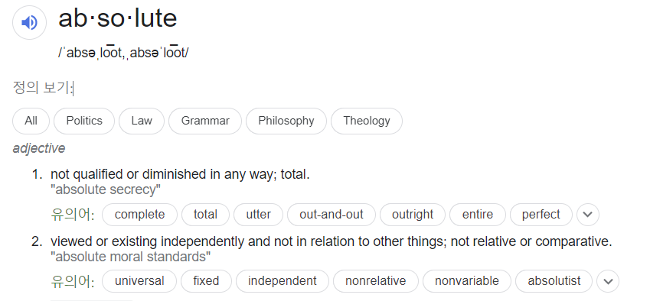
4
not qualified or diminished in any way; total.
Not relative or comparative
1. dictionary meaning of absolute

Slide 5

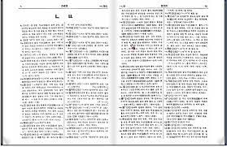
5
Is there really absolute?
Dictionary
not qualified or diminished in any way; total.
Not relative or comparative
1. What is absolute ( only my thing )

Slide 6
6
2. What is absolute
( only my thing )

Slide 7
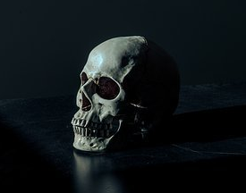
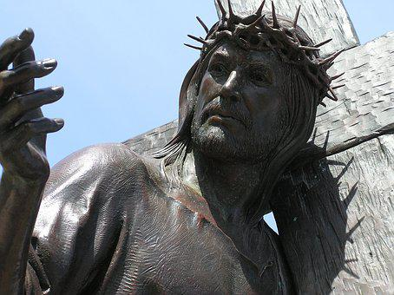
7
Absolute is …
NOThING at all
Exclude
DEATH
GOT
2. What is absolute ( only my thing )

Slide 8
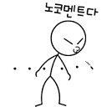
8
All absolute views cannot come from a person
absolute
2. What is absolute ( only my thing )

Slide 9
9
Because people's thoughts are very subjective.
relative
2. What is absolute ( only my thing )

Slide 10

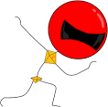
10
I have to think about the fact that my thoughts may not be objective
Because my thoughts are my thoughts? Isn’t that what parents think?
Grandma
parent
children
2. What is absolute ( only my thing )

Slide 11

11
absolute views cannot exist
absolute
2. What is absolute ( only my thing )

Slide 12
12
Absolute Evil
3. Damien's
Absolute Good

Slide 13
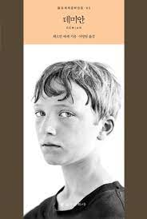
13
In Damian's novel,
Aile Sinkrere confused between good and evil
After seeing he’s friend Damian,
The contents of the book are not important.
2. Damien's Absolute Evil, Absolute Good

Slide 14
In Damien's
14
Is there absolute good and absolute evil?

Slide 15
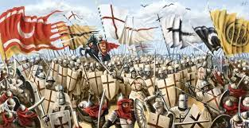
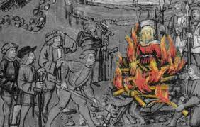
History
15
Human has used this ideology
The Crusades
Witch hunt

Slide 16
16
good, evil?
I think it's absolute, but it's actually a relatively circular algorithm
It's an algorithm that I think is absolute
relatively
absolute
relatively
absolute

Slide 17
17
This is a subjective thought. An objective thought
Am I right or wrong?
Is there a got or not?

Slide 18
finish

Slide 19
1. What do you think is absolute?
2. Is the absolute thing you thought was absolute?

